Slide 1
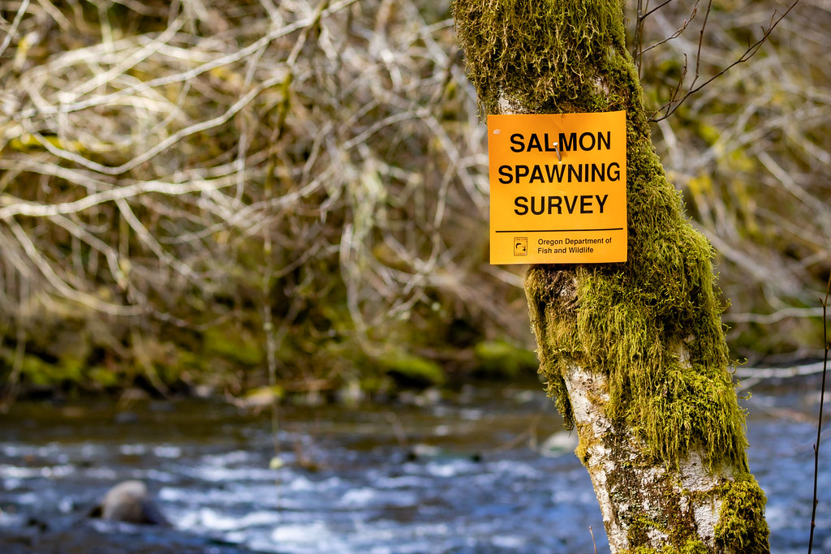
Understanding precision and directional bias of fisheries abundance estimates across 31 commonly used salmonid survey methods

Slide 2
Background

Slide 3
What are salmon?

Slide 4
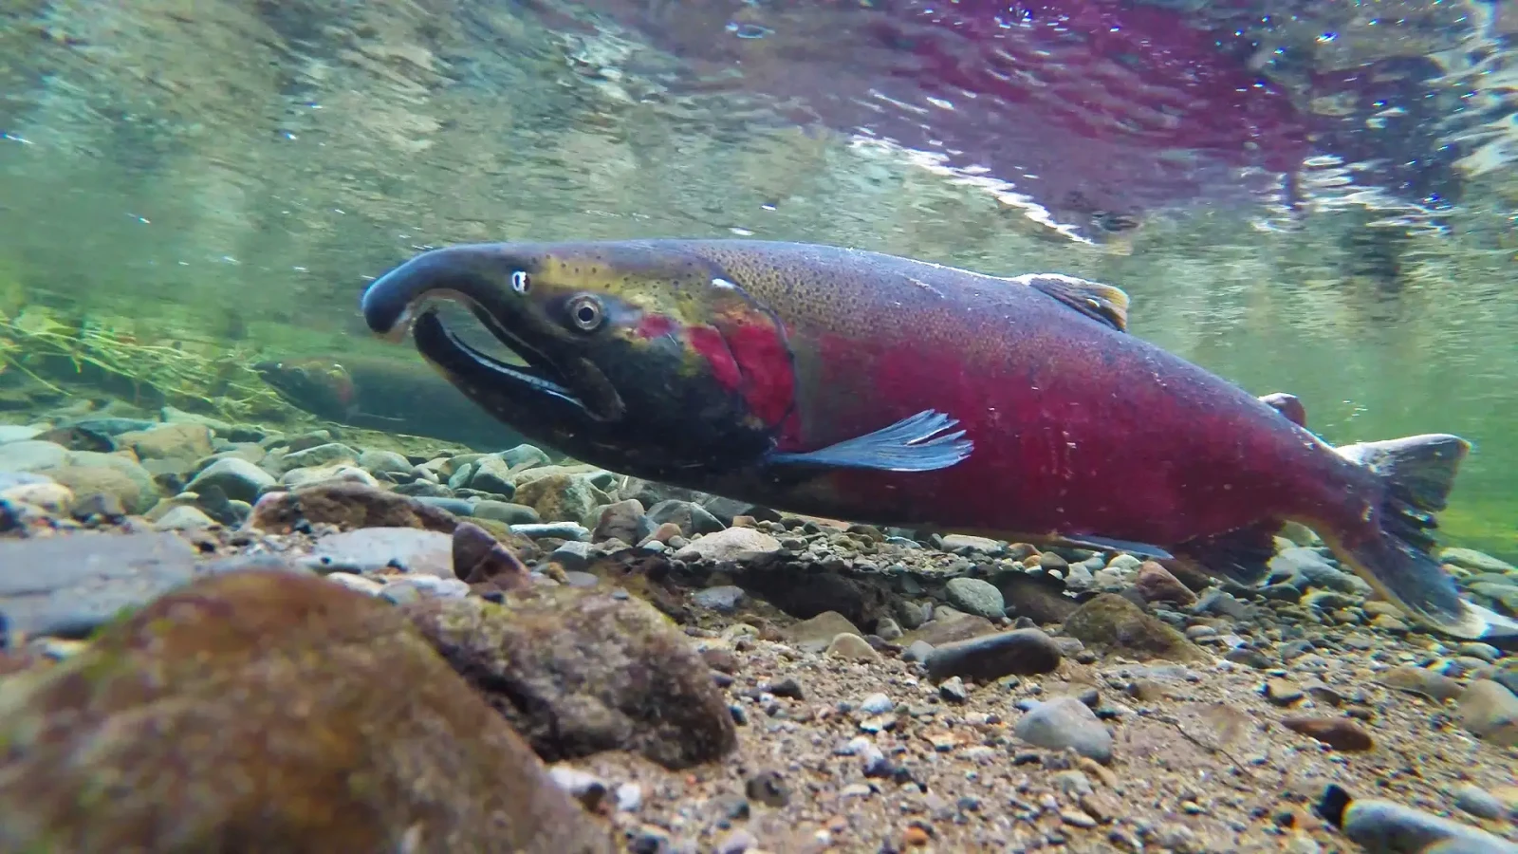
What are salmon?
Photo credit: Animalia

Slide 5
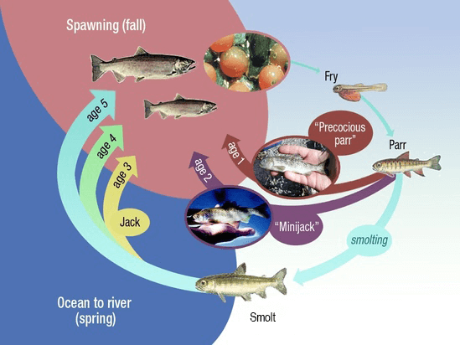
What are salmon?
Photo credit: NOAA Fisheries

Slide 6
Why salmon are important?

Slide 7
Why salmon are important?
Ecologically crucial species

Slide 8
Why salmon are important?
Ecologically crucial species
Marine nutrients found in trees in central Idaho

Slide 9
Why salmon are important?
Ecologically crucial species
Marine nutrients found in trees in central Idaho
Cultural significance

Slide 10
Why salmon are important?
Ecologically crucial species
Marine nutrients found in trees in central Idaho
Cultural significance
Central to Indigenous ways of life and cultural identity

Slide 11
Why salmon are important?
Ecologically crucial species
Marine nutrients found in trees in central Idaho
Cultural significance
Central to Indigenous ways of life and cultural identity
Commercial significance

Slide 12
Why salmon are important?
Ecologically crucial species
Marine nutrients found in trees in central Idaho
Cultural significance
Central to Indigenous ways of life and cultural identity
Commercial significance
$7.2 million in OR in 2024

Slide 13
How are salmon doing?

Slide 14
How are salmon doing?
Not great in the lower 48

Slide 15
How are salmon doing?
Not great in the lower 48
28 population groups of salmon/trout listed as endangered or threatened under ESA

Slide 16
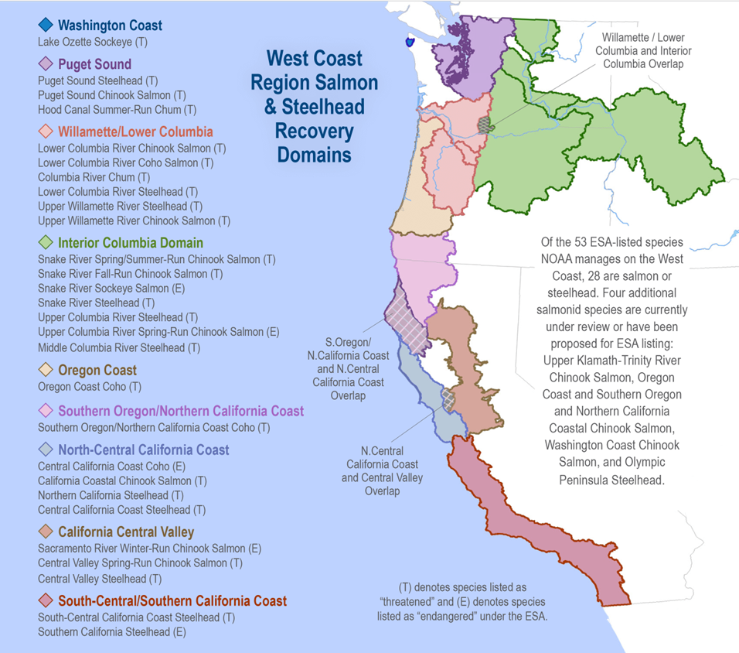
Photo credit: NOAA Fisheries

Slide 17
How are salmon doing?
Not great in the lower 48
28 population groups of salmon/trout listed as endangered or threatened under ESA
13 of these in Columbia Basin

Slide 18
How are salmon doing?
Not great in the lower 48
28 population groups of salmon/trout listed as endangered or threatened under ESA
13 of these in Columbia Basin
Despite restoration efforts

Slide 19
How are salmon doing?
Not great in the lower 48
28 population groups of salmon/trout listed as endangered or threatened under ESA
13 of these in Columbia Basin
Despite restoration efforts
$ 9 billion spent in Columbia Basin since 1990s

Slide 20
How do we know how salmon are doing?

Slide 21
How do we know how salmon are doing?
We count them!

Slide 22
How do we know how salmon are doing?
We count them!
Well, we count some of them

Slide 23
How do we know how salmon are doing?
We count them!
Well, we count some of them and make educated guesses about the rest…

Slide 24
How do we know how salmon are doing?
We count them!
Well, we count some of them and make educated guesses about the rest…
Using a variety of survey methods and monitoring techniques

Slide 25

How do we know how salmon are doing?
Photo credit: US Bureau of Land Management

Slide 26
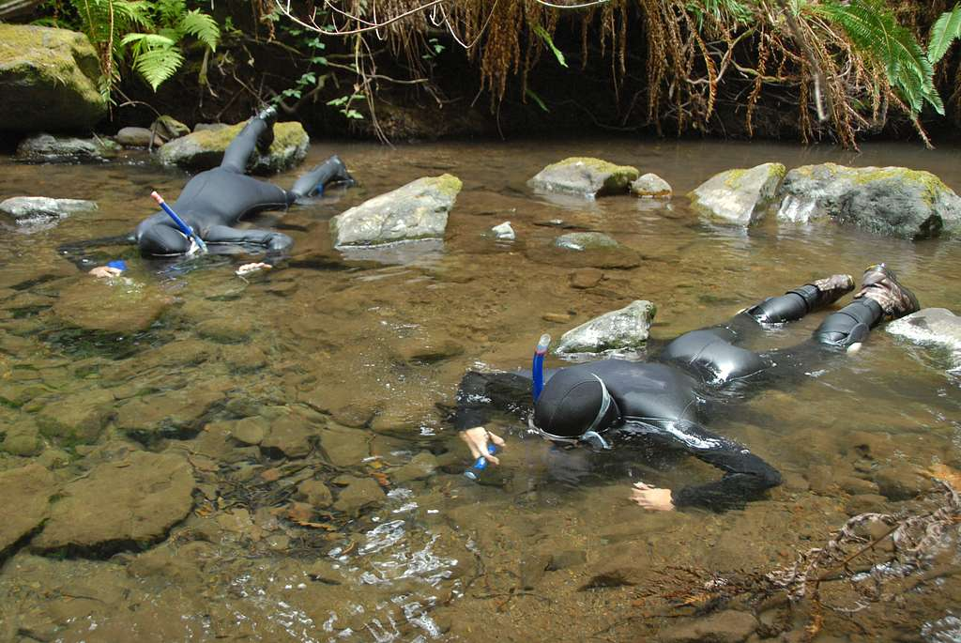
How do we know how salmon are doing?
Photo credit: National Parks Gallery

Slide 27
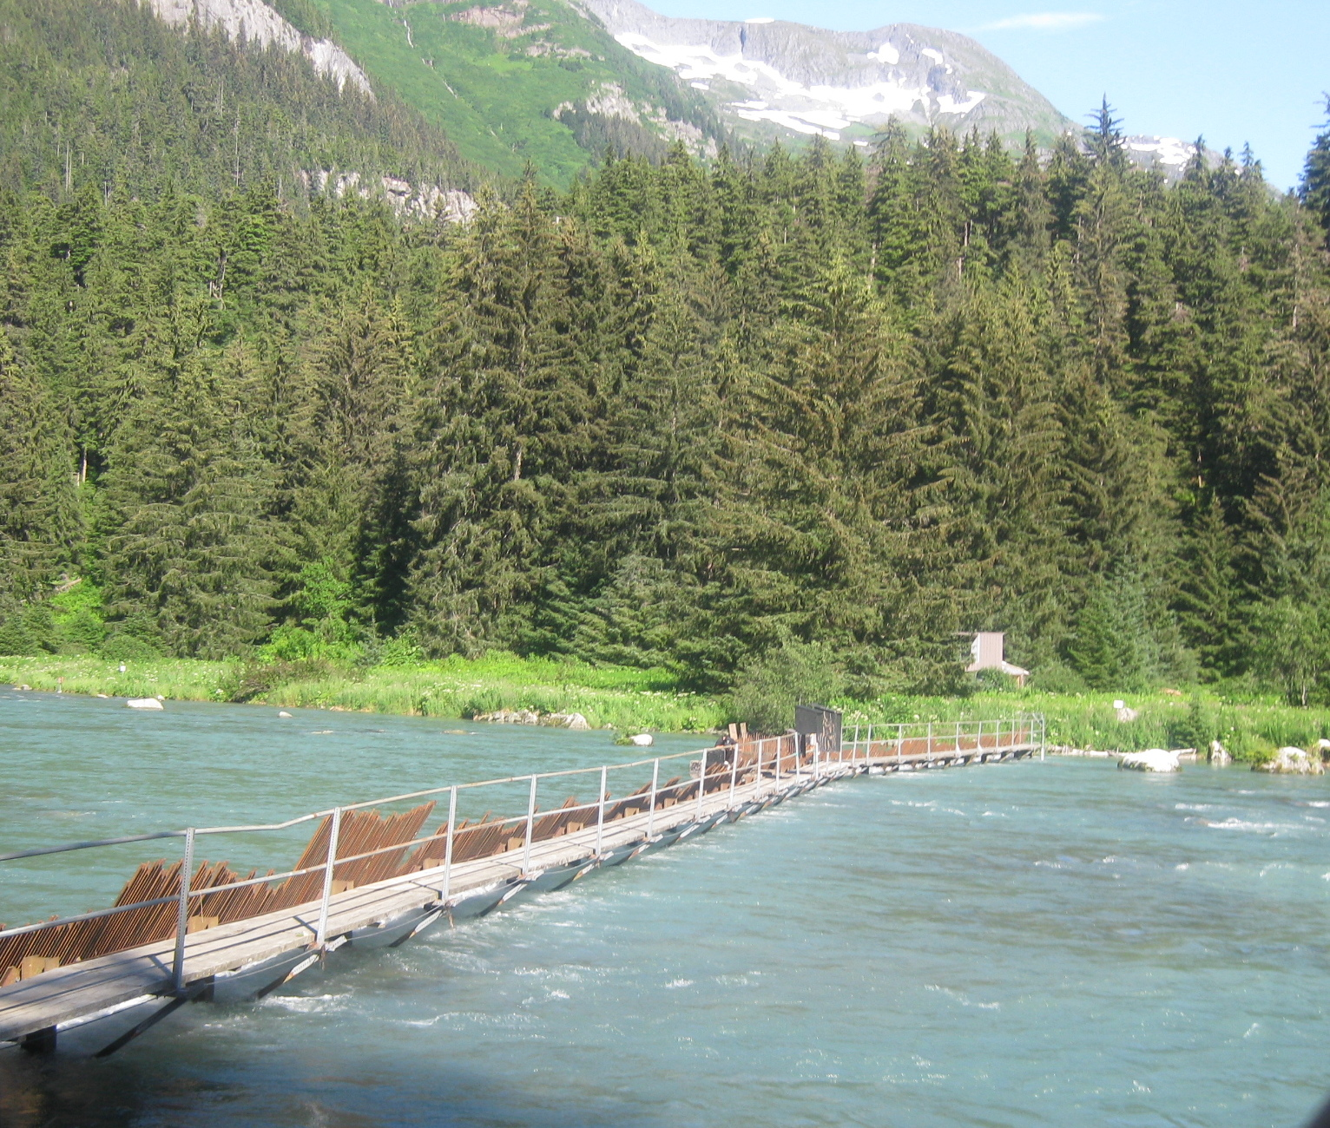
How do we know how salmon are doing?
Photo credit: Wikipedia Commons

Slide 28
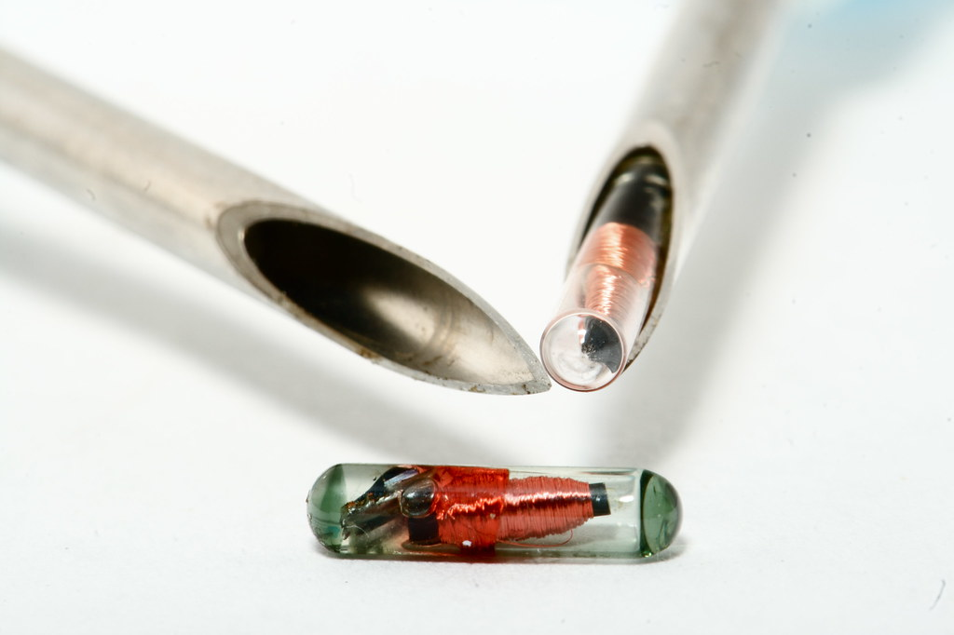
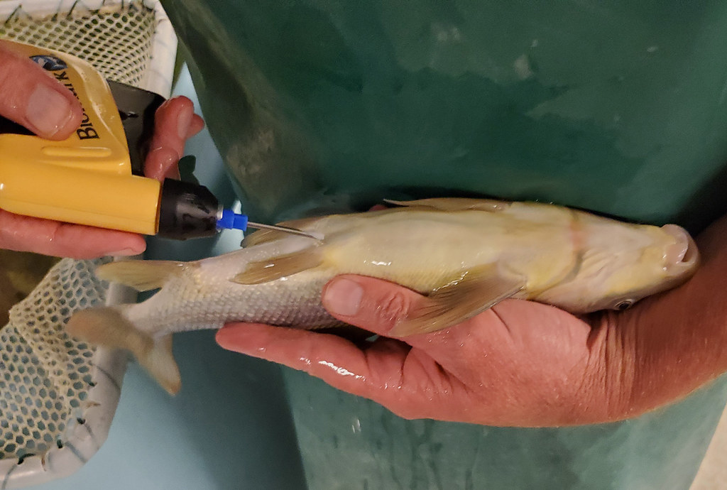
How do we know how salmon are doing?
Photo credit: US Fish and Wildlife Service

Slide 29

How do we know how salmon are doing?
Photo credit: Nic McPhee

Slide 30
How do we know how salmon are doing?

Slide 31
Research goal: Evaluate salmon survey methods for precision and directional bias

Slide 32
Data

Slide 33
Data
Spawning salmon estimates in Oregon
68 salmonid populations
3 species: Chinook, coho, steelhead
Annual observations, 1980 to 2022
31 survey methods

Slide 34
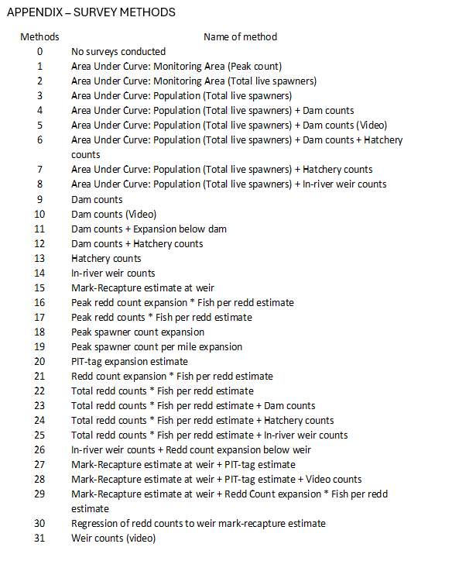
Data – survey methods

Slide 35
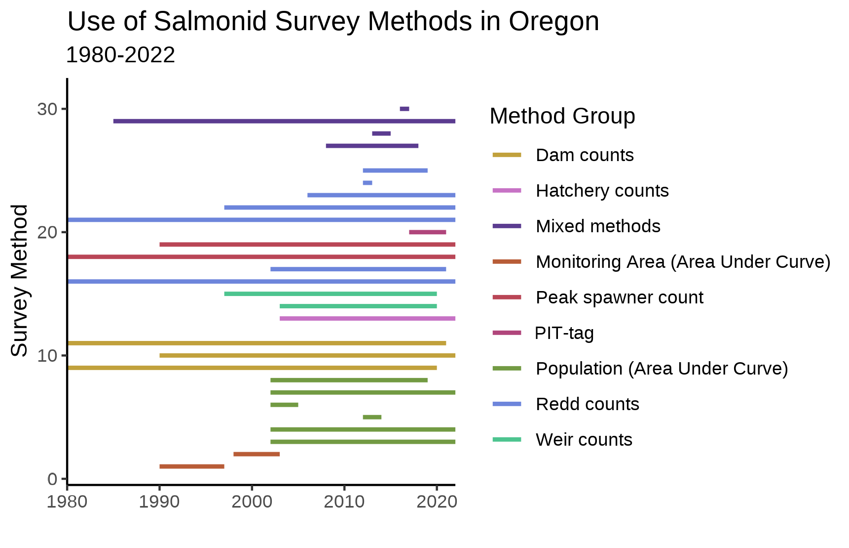
Data – survey methods

Slide 36
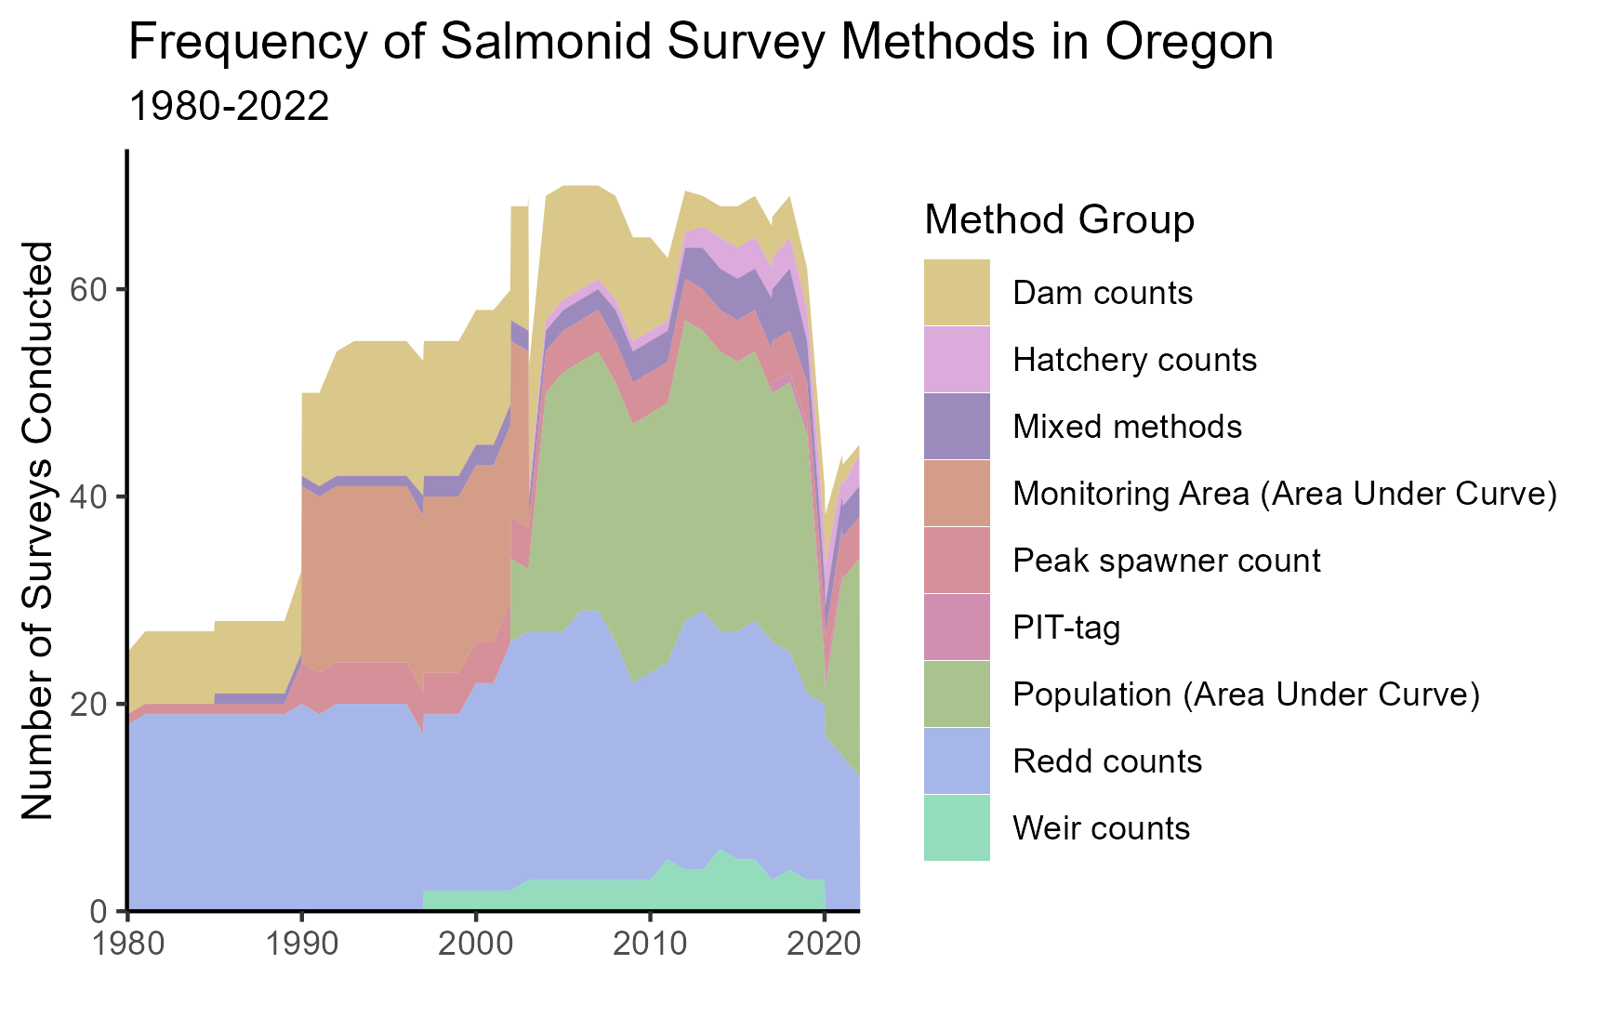
Data – survey methods

Slide 37
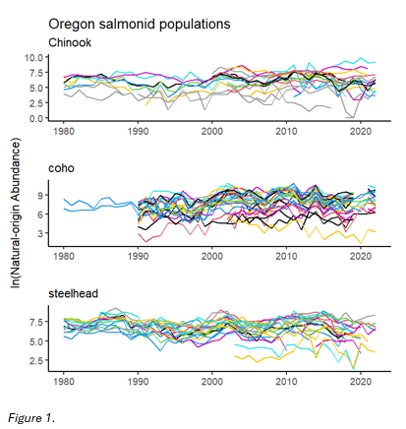
Data – abundance estimates

Slide 38
Analysis

Slide 39
Modeling approach
Multivariate Auto-Regressive State Space models
(MARSS)

Slide 40
Modeling approach
Multivariate Auto-Regressive State Space models
(MARSS)
Estimates underlying state based on observations

Slide 41
Modeling approach
Multivariate Auto-Regressive State Space models
(MARSS)
Estimates underlying state based on observations
Distinguishes observation error from noise in state being observed

Slide 42
Modeling approach
Multivariate Auto-Regressive State Space models
(MARSS)
x_{t} = Bx_{t−1} + u + w_{t}, where w_{t}∼MVN(0,Q)
y_{t} = Zx_{t} + a + v_{t}, where v_{t}∼MVN(0,R)

Slide 43
Modeling approach
MARSS models
Observation equation
x_{t} = Bx_{t−1} + u + w_{t}, where w_{t}∼MVN(0,Q)
y_{t} = Zx_{t} + a + v_{t}, where v_{t}∼MVN(0,R)

Slide 44
Modeling approach
MARSS models
Underlying state/process equation
x_{t} = Bx_{t−1} + u + w_{t}, where w_{t}∼MVN(0,Q)
y_{t} = Zx_{t} + a + v_{t}, where v_{t}∼MVN(0,R)

Slide 45
Modeling approach
Multivariate Auto-Regressive State Space models
Important features?
x_{t} = Bx_{t−1} + u + w_{t}, where w_{t}∼MVN(0,Q)
y_{t} = Zx_{t} + a + v_{t}, where v_{t}∼MVN(0,R)

Slide 46
Modeling approach
Multivariate Auto-Regressive State Space models
Important features
x_{t} = Bx_{t−1} + u + w_{t}, where w_{t}∼MVN(0,Q)
y_{t} = Zx_{t} + a + v_{t}, where v_{t}∼MVN(0,R)
Data

Slide 47
Modeling approach
Multivariate Auto-Regressive State Space models
Important features
x_{t} = Bx_{t−1} + u + w_{t}, where w_{t}∼MVN(0,Q)
y_{t} = Zx_{t} + a + v_{t}, where v_{t}∼MVN(0,R)
Data
Underlying state (estimates)

Slide 48
Modeling approach
Multivariate Auto-Regressive State Space models
Important features
x_{t} = Bx_{t−1} + u + w_{t}, where w_{t}∼MVN(0,Q)
y_{t} = Zx_{t} + a + v_{t}, where v_{t}∼MVN(0,R)
Data Trend (bias)
Underlying state (estimates)

Slide 49
Modeling approach
Multivariate Auto-Regressive State Space models
Important features
x_{t} = Bx_{t−1} + u + w_{t}, where w_{t}∼MVN(0,Q)
y_{t} = Zx_{t} + a + v_{t}, where v_{t}∼MVN(0,R)
Data Trend (bias)
Underlying state (estimates) Error terms

Slide 50
Modeling approach
What am I concerned with?
x_{t} = Bx_{t−1} + u + w_{t}, where w_{t}∼MVN(0,Q)
y_{t} = Zx_{t} + a + v_{t}, where v_{t}∼MVN(0,R)
Data Trend (bias)
Underlying state (estimates) Error terms

Slide 51
Modeling approach
What am I concerned with?
x_{t} = Bx_{t−1} + u + w_{t}, where w_{t}∼MVN(0,Q)
y_{t} = Zx_{t} + a + v_{t}, where v_{t}∼MVN(0,R)
I am interested in observation bias (a) and observation variance (R)

Slide 52
Results

Slide 53
Results
Precision (R) and bias (a) terms estimated for 19 survey methods

Slide 54
Results
Precision (R) and bias (a) terms estimated for 19 survey methods
Not every method evaluated for every species

Slide 55
Results
Precision (R) and bias (a) terms estimated for 19 survey methods
Not every method evaluated for every species
12 methods with very few data points in the time series

Slide 56
Results
Precision (R) and bias (a) terms estimated for 19 survey methods
Not every method evaluated for every species
12 methods with very few data points in the time series
Bias can only be estimated relative to pre-specified reference method

Slide 57
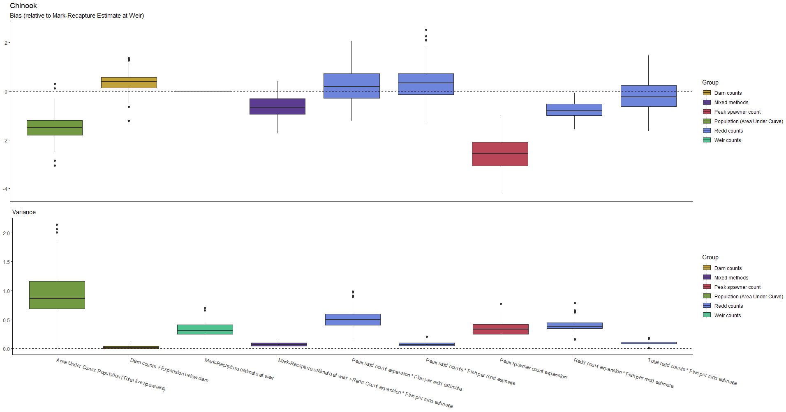
Results - Chinook

Slide 58
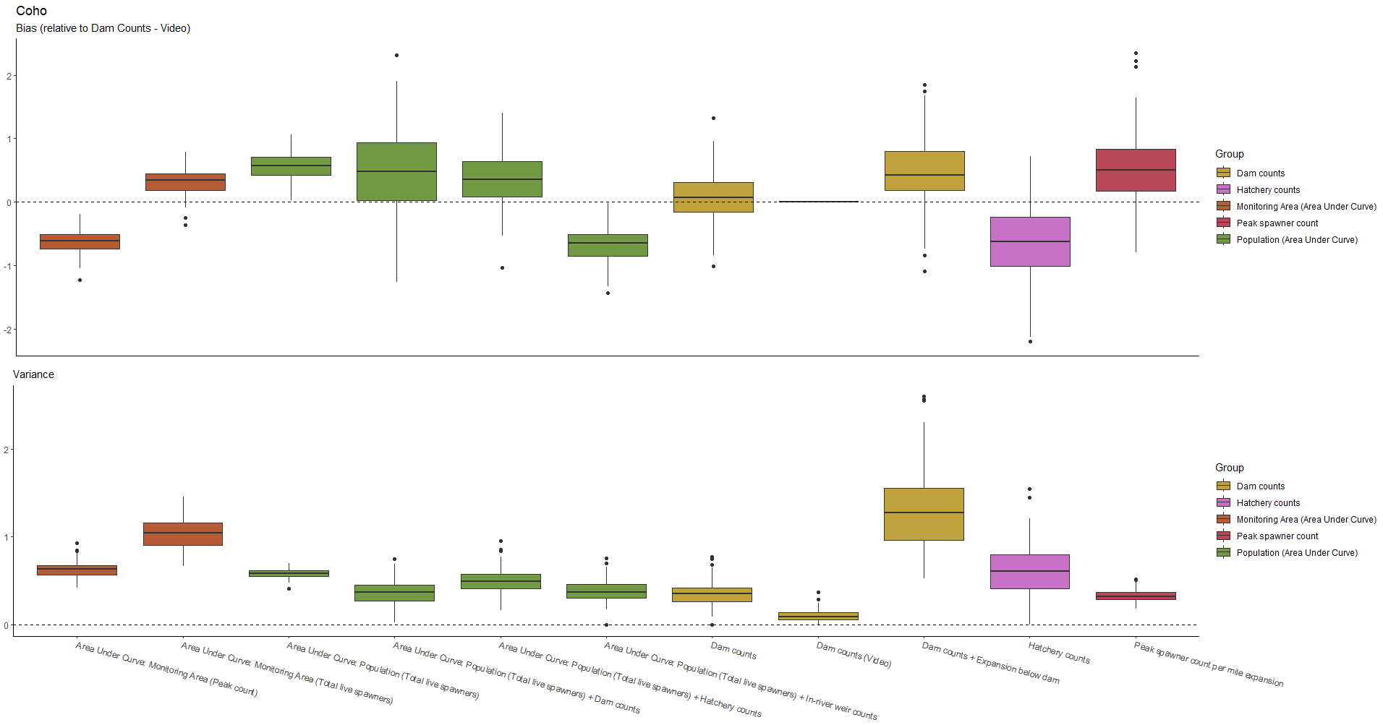
Results - Chinook

Slide 59
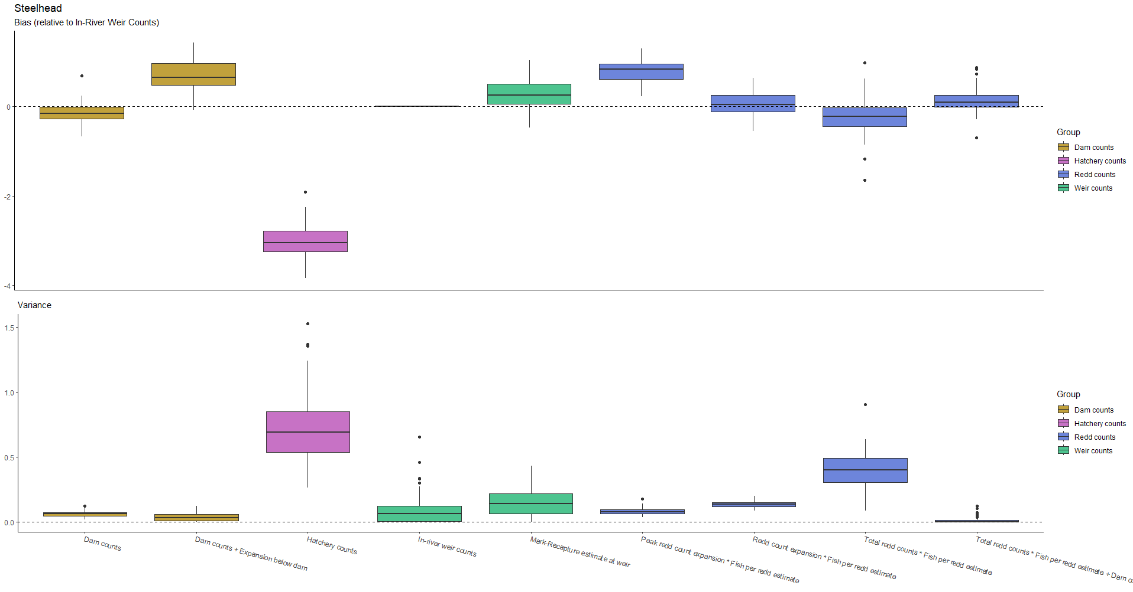
Results - Chinook

Slide 60
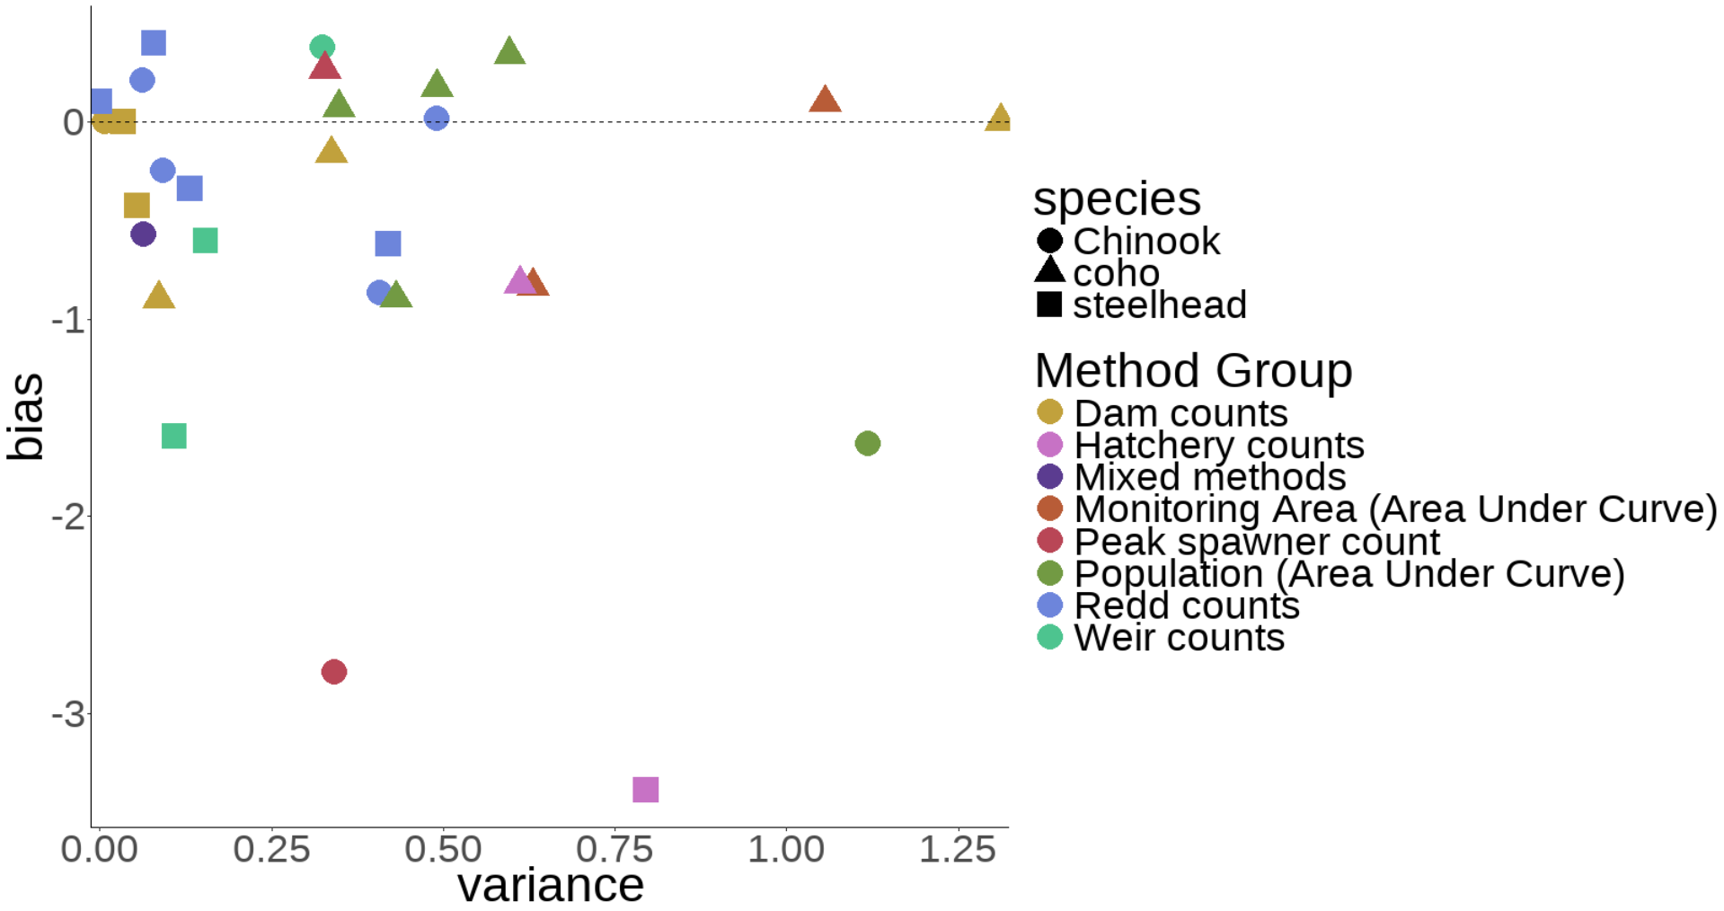
Results – all species
Reference method: Dam counts + Expansion below dam, a=0

Slide 61
Results
The same survey method can have very different levels of precision between species

Slide 62
Results
The same survey method can have very different levels of precision between species
Area-under-curve methods perform reasonably well for coho and poorly for Chinook

Slide 63
Results
The same survey method can have very different levels of precision between species
Area-under-curve methods perform reasonably well for coho and poorly for Chinook
Bias also seen to trend in different directions across species

Slide 64
Results
Coho generally more difficult to count precisely than Chinook or steelhead

Slide 65
Results
Coho generally more difficult to count precisely than Chinook or steelhead
Dam counts, weir counts, and redd counts tend to be most precise

Slide 66
Results
Coho generally more difficult to count precisely than Chinook or steelhead
Dam counts, weir counts, and redd counts tend to be most precise
Hatchery counts are terrible

Slide 67
Discussion & Next Steps

Slide 68
Discussion
Wide variety of survey methods available to biologists

Slide 69
Discussion
Wide variety of survey methods available to biologists
Understanding bias and precision is crucial

Slide 70
Discussion
Wide variety of survey methods available to biologists
Understanding bias and precision is crucial
Decisions such as ESA listing and restoration funding are dependent on accurate estimates

Slide 71
Next Steps
Evaluate cost of survey methods
Value of information

Slide 72
Next Steps
Evaluate cost of survey methods
Value of information
Consider tradeoffs between cost and accuracy
More accurate counts valuable for most vulnerable populations?

Slide 73
Next Steps
Evaluate cost of survey methods
Value of information
Consider tradeoffs between cost and accuracy
More accurate counts valuable for most vulnerable populations?
Optimizing utility of limited budgets

Slide 74





Understanding precision and directional bias of fisheries abundance estimates across 31 commonly used salmonid survey methods
Brian McGreal bmcgreal@uw.edu

Slide 75
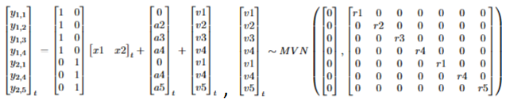
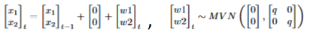
Modeling approach
Specifying matrices properly is crucial

Slide 76
Modeling approach
Specifying matrices properly is crucial
A reference method must be chosen to estimate bias

Slide 77
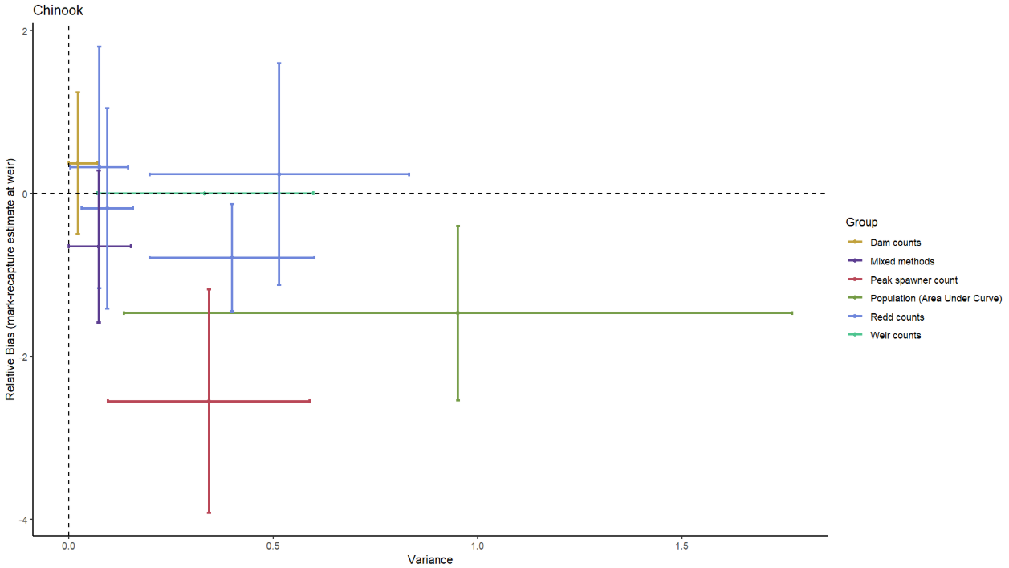
Results - Chinook

Slide 78
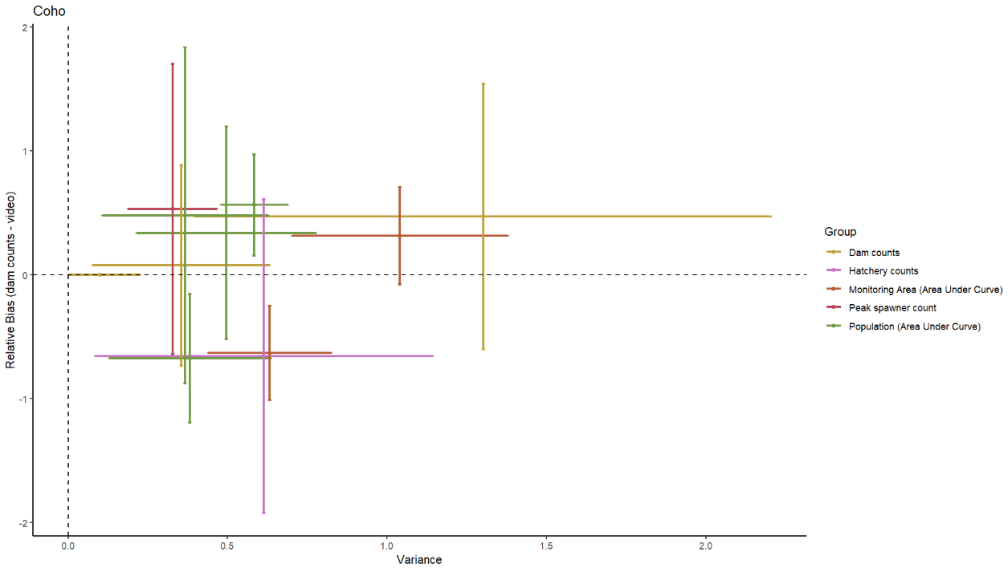
Results - coho

Slide 79
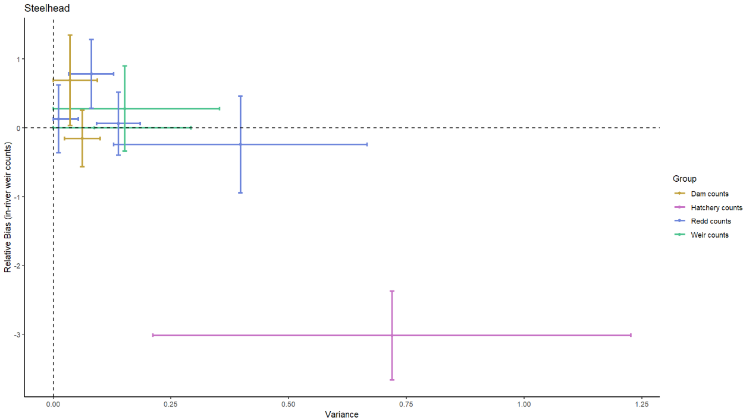
Results - steelhead

Slide 80
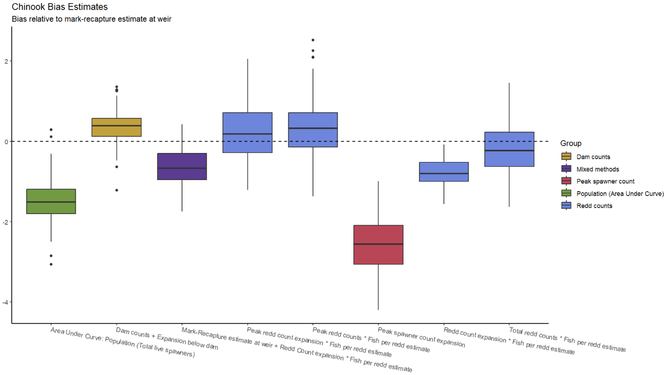
Results - Chinook

Slide 81
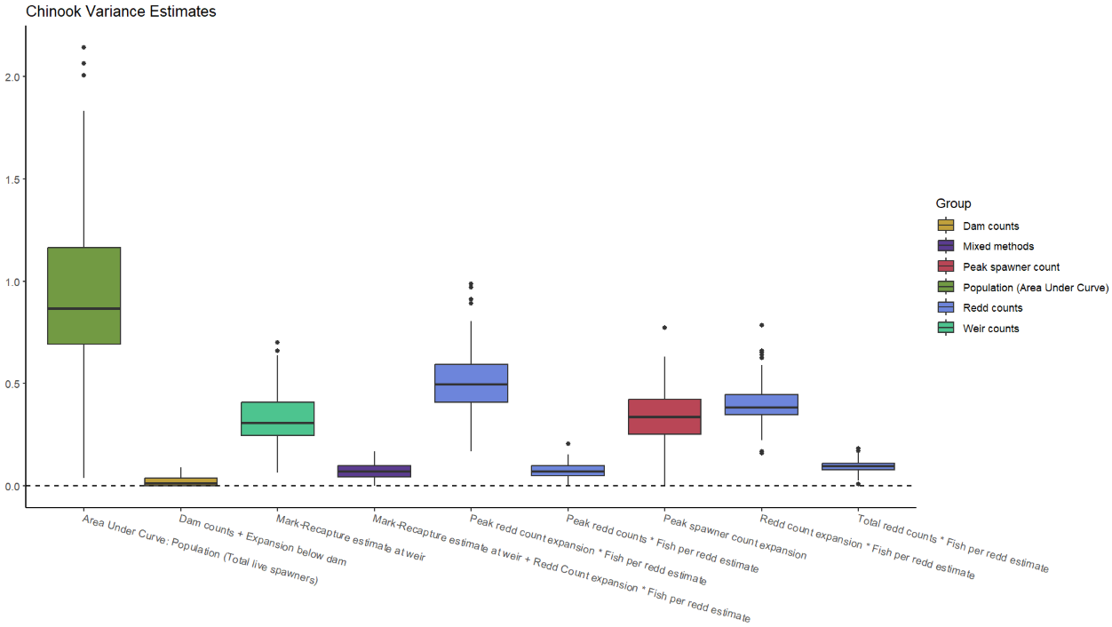
Results - Chinook

Slide 82
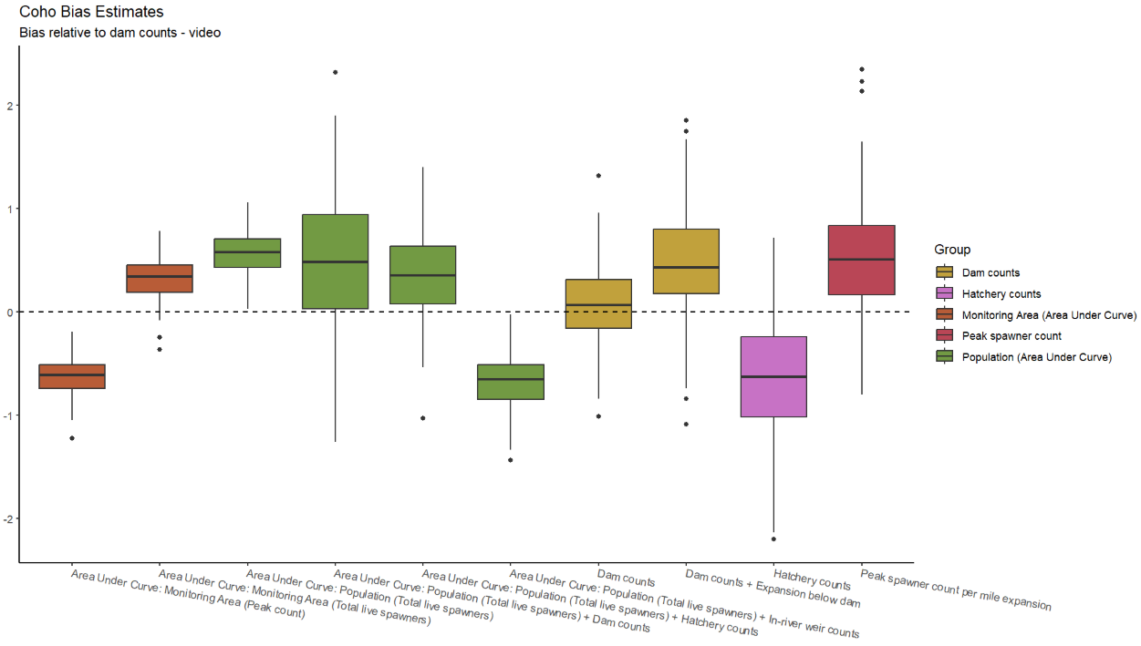
Results - coho

Slide 83
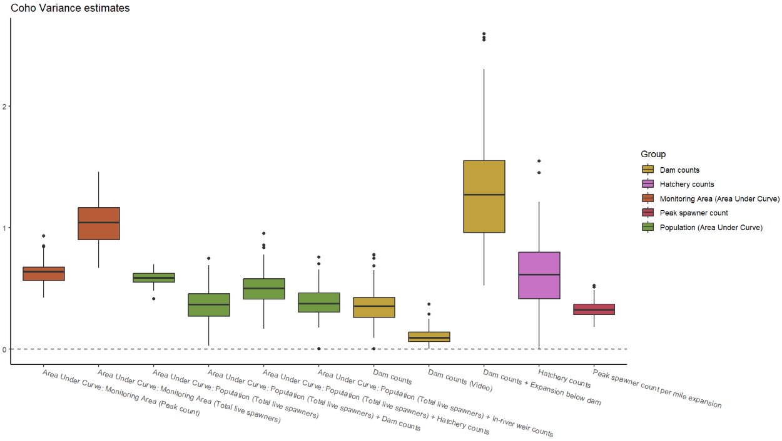
Results - coho

Slide 84
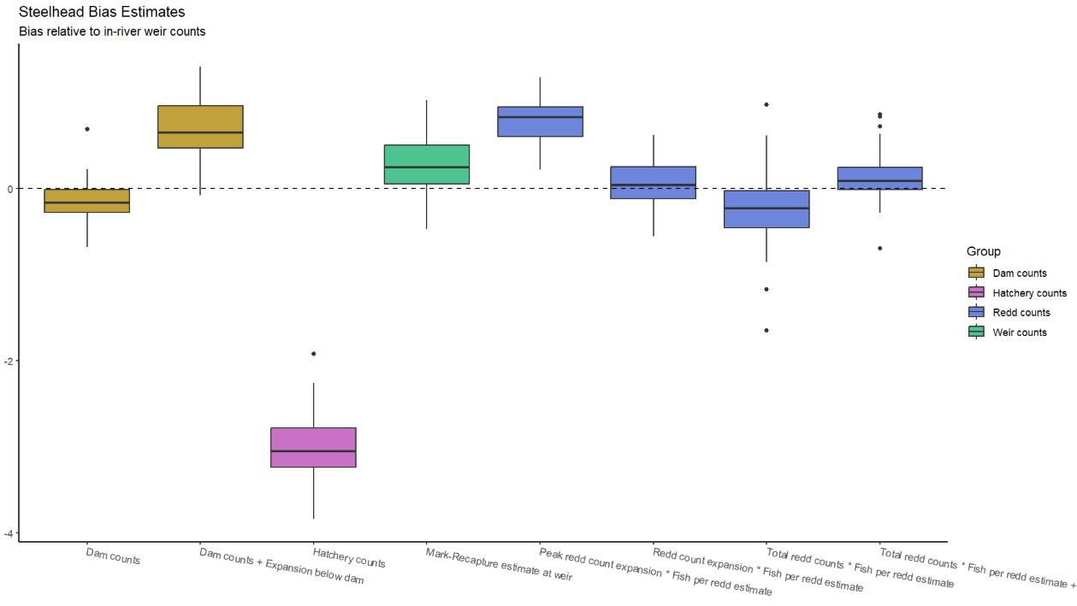
Results - steelhead

Slide 85
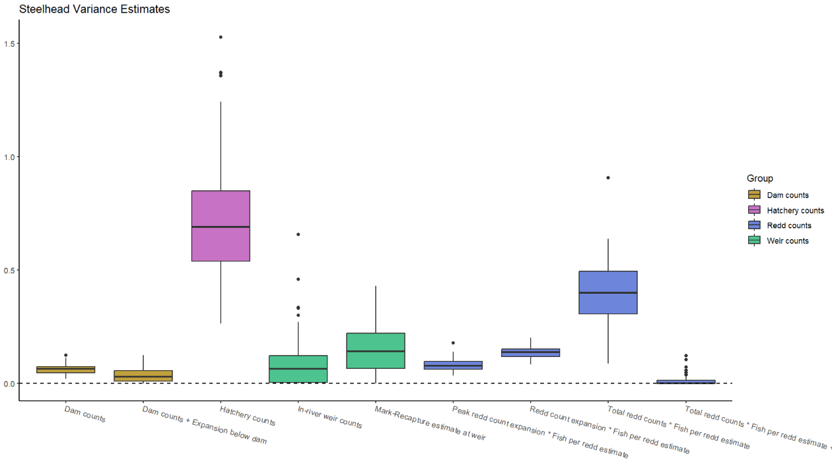
Results - steelhead

